Slide 1

Unit - IV
Deepa R
Assistant Professor
IT department

Slide 2

Is the design of interactive products and services in which a designers focus goes beyond the item in development to include the way users will interact with it.
Here the focus is in designing interactive products to support the way people communicate and interact in their everyday and working lives

Slide 3

Usability goals
User experience goals

Slide 4

  Effective to use (effectiveness)
  Efficient to use (efficiency)
  Safe to use (safety)
  Have good utility (utility)
  Easy to learn (learnability)
  Easy to remember how to use (memorability)

Slide 5

Satisfying
Enjoyable
Fun
Entertaining
Helpful
Motivating
Aesthetically pleasing
Supportive of creativity
Regarding
Emotionally fulfilling

Slide 6

Visibility
Feedback
Constraints
Consistency
Affordance

Slide 7

Visibility of system status
Match between system and real world
User control and freedom
Consistency and standards
Help users recognize, diagnose, and recover from errors
Error prevention
Recognition rather than recall
Flexibility and efficiency of use
Aesthetic and minimalist design
Help and documentation

Slide 8

Are there problems with an existing product? If so, what are they? Why do you think there are problems?
Why do you think your proposed ideas might be useful? How do you envision people integrating your proposed design with how they currently do things in their everyday or working lives
How will your proposed design support people in their activities? In what way does it address an identified problem or extend current ways of doing things? Will it really help

Slide 9

A description of the proposed system in terms of a set of integrated ideas and concepts about what it should do, behave and look like, that will be understandable by the users in the manner intended
A conceptual model is a high level description of how a system is organized and operates

Slide 10

The major metaphors and analogies
The concepts
The Relationship between the concepts
The mappings

Slide 11

An interface metaphor is considered to be a central component of a conceptual model.
It provides a structure that is similar in some way to aspects of familiar entity but that also has its own behaviors and properties.

Slide 12

Metaphors are commonly used to explain something that is unfamiliar or hard to grasp by the way of comparison with something that is familiar and easy to grasp.
Interface metaphors have proven to be highly successful, providing users with a familiar orienting device and helping them understand and learn how to use a system

Slide 13

Based on activities
  Instructing
  Conversing
  Manipulating and navigating
  Exploring and browsing
Besides the 4 core activities of instructing , conversing and manipulating and exploring there are many other ways of describing the specific domain and context based activities.
eg. Problem solving, information searching and decision making

Slide 14

Theories
Models
Frameworks
The Designer’s Model- The model the designer has of how the system should work
The system image- how the system actually works is portrayed to the user through the interface , manuals, help facilities etc.
The User’s model – how the user understands how the system works

Slide 15

Experimental Cognition
State of mind in which we perceive, act and react to events around us effectively and effortlessly. It requires reaching a certain level of expertise and engagement.
Reflective Cognition
Involves thinking, comparing and decision making. This kind of cognition will leads to new ideas and creativity.

Slide 16

Cognition has also been described in terms of kinds of processes.
Attention
Perception
Memory
Learning
Reading, speaking and listening
Problem solving, planning, reasoning and decision making

Slide 17

Internal
1. Mental models
2.Gulfs of Execution and evaluation
3.Information Processing
External
1. Distributed Cognition
2. External Cognition
3.Embodied Interaction

Slide 18

Mental models are used by people to reason about a system and in particular , to try to fathom out what to do when something unexpected happens with the system or when encountering unfamiliar systems.
The more someone learns about the system and how it functions the more their mental model develops.

Slide 19

The gulf of Execution and the gulf of evaluation describe the gaps that exist between the user and the interface.
Gulf of execution – distance from the user to the physical system
Gulf of evaluation – distance from the physical system to the user.

Slide 20

Input
or
Stimuli
Encoding
Comparison
Response selection
Response execution
Output
or
response
Stage 1 Stage 2 Stage 3 Stage 4
Human Information Processing Model

Slide 21

Distributed cognition approach studies the nature of cognitive phenomena across individuals, artifacts and internal and external
representations

Slide 22
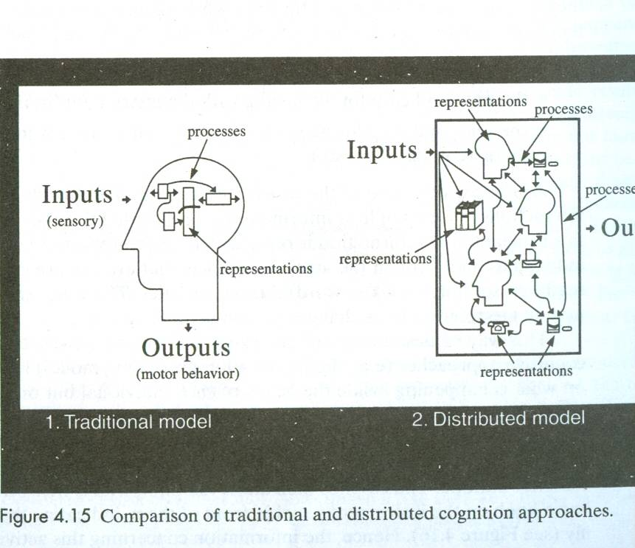

Slide 23

Externalizing to reduce memory load
Computational offloading
Annotating and cognitive tracing

Slide 24

Reminding them to do something
Reminding them of what to do
Reminding them of when to do something

Slide 25

Computational Offloading occurs when we use a tool or device in conjunction with an
external representation to help us carry out a computation.

Slide 26

Annotating involves modifying external representations, such as crossing off or underlining items
Cognitive tracing involves externally manipulating items into different orders or structures

Slide 27

Conversational mechanisms
Coordination mechanisms
Awareness mechanisms

Slide 28

Rule 1: the current speaker chooses the next speaker by asking an opinion, question or request
Rule 2: another person decides to start speaking
Rule 3: The current speaker continues talking
Email, videoconferencing, video phones, computer conferencing, chat rooms and messaging, collaborative virtual environments

Slide 29

Synchronous communication
  Eg: Video phones, conferencing
Asynchronous communication
  Eg: Email, bulletin boards, newsgroups
CMC combined with other activity
  Eg: customized electronic meeting rooms

Slide 30

Verbal and non-verbal communication
Schedules, rules and conventions
Shared external representations
Shared calendars, electronic schedulers, project management tools, workflow tools

Slide 31

Involves knowing who is around, what is happening, and who is talking with whom
Overhearing and overseeing

Slide 32

Assertives – commit the speaker to something being the case
Commissives – commit the speaker to some future action
Declarations – pronounce something has happened
Directives – Get the listener to do something
Expressives – express a state of affairs, such as apologizing or praising someone

Slide 33
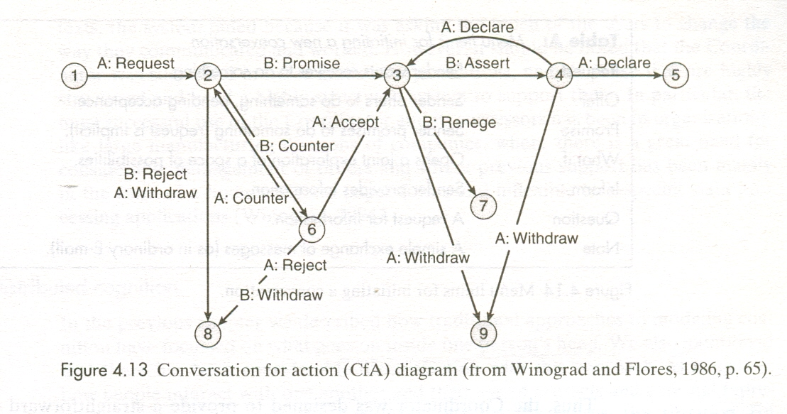

Slide 34
